Slide 1
ALMA MATER STUDIORUM – UNIVERSITÀ DI BOLOGNA
Project for Machine Learning Systems For
Data Science
Module 2
Academinc year 2023-24
Tommaso Fiori

Slide 2

Scope
E-mail summary and classification.

Slide 3
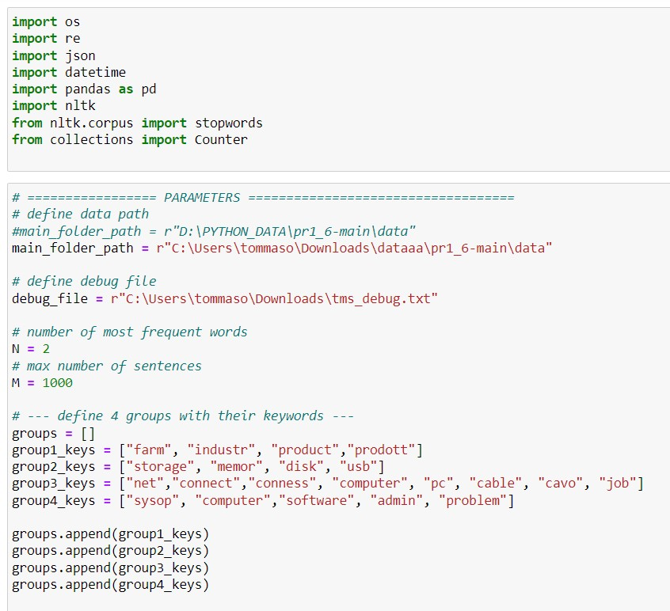
Used library and Parameters

Slide 4
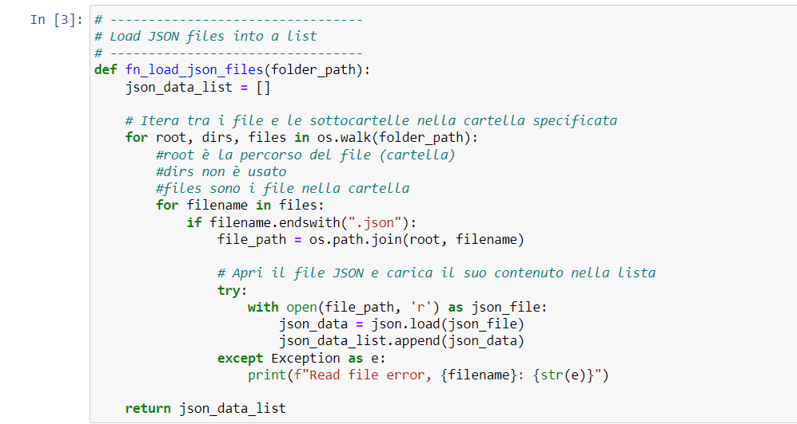
Data Import

Slide 5
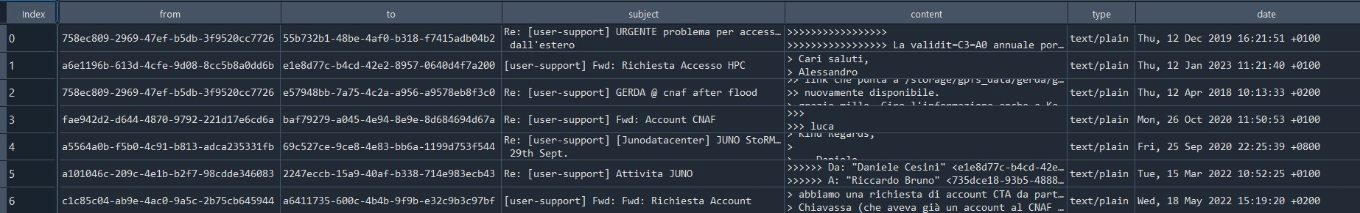
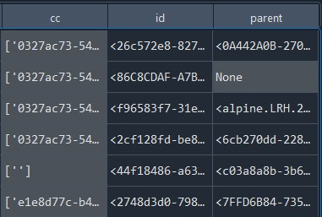
Dataset
Dataset

Slide 6

E-mail summary
E-mail sentences
separation
E-mail replies
remotion
Senteces selection with most frequent words - Summary
- Cleaning
- Stop word
Most frequent
word extraction

Slide 7
E-mail classification
Coherent words:
- Storage
- Farming
- Net
- Sysop
- Cleaning
- Stop word
Most frequent
word extraction
Classification defintion

Slide 8
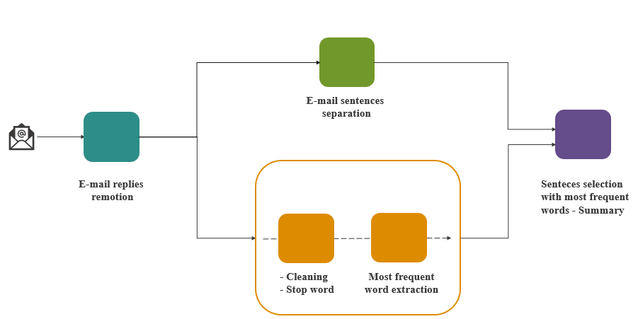
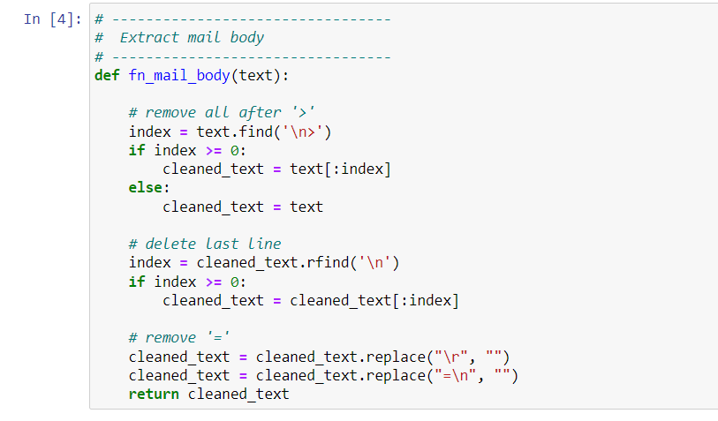
E-mail summary
E-mail replies remotion – fn_mail_body

Slide 9
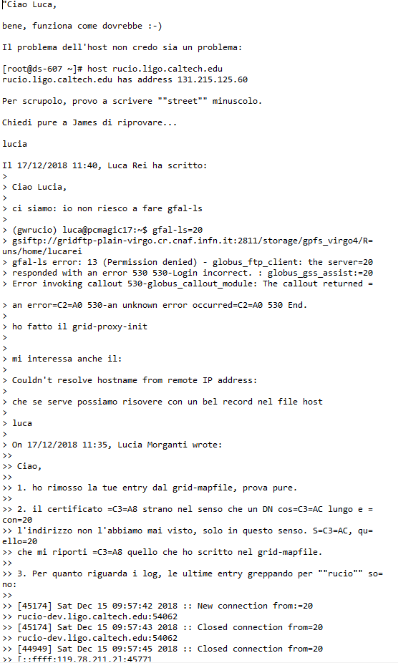
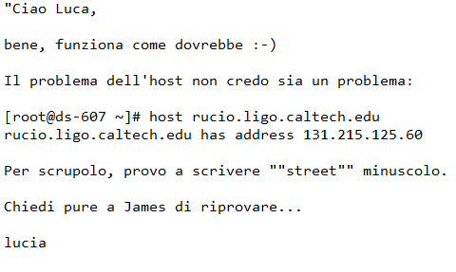
fn_mail_body

Slide 10
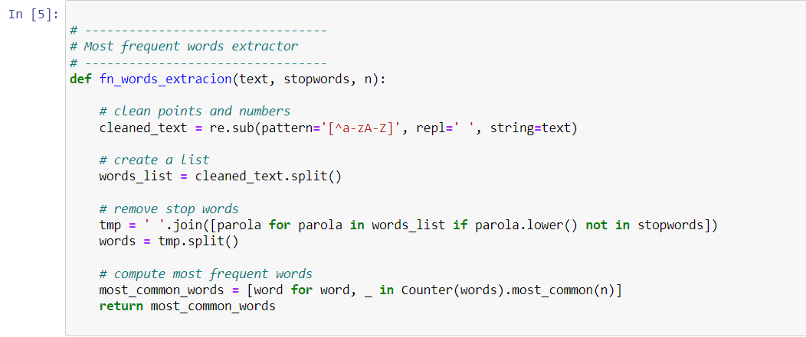
E-mail summary
- Cleaning and Stop word
- Most frequent word extraction
– fn_words_extraction

Slide 11
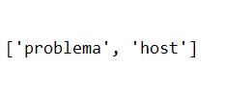
fn_words_extraction

Slide 12
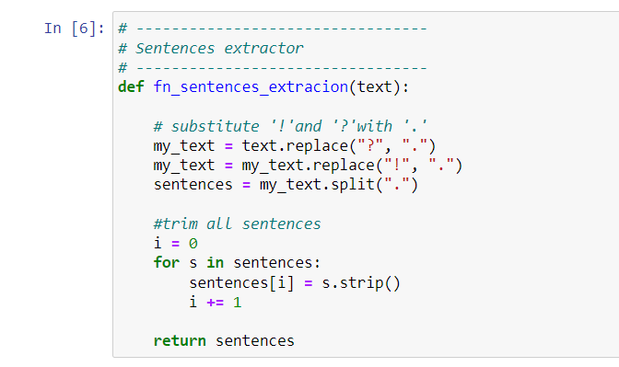
E-mail summary
E-mail sentences separation – fn_sentences_extraction

Slide 13
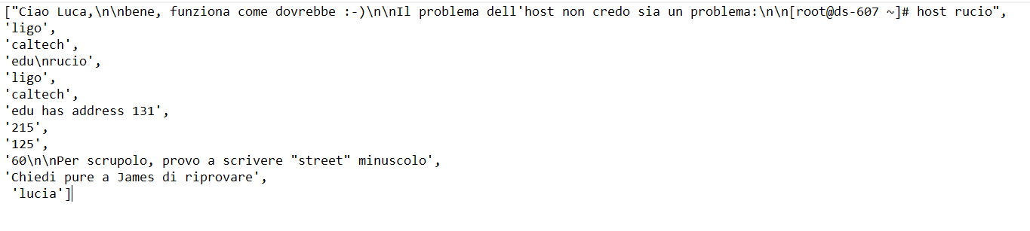
fn_sentences_extraction

Slide 14
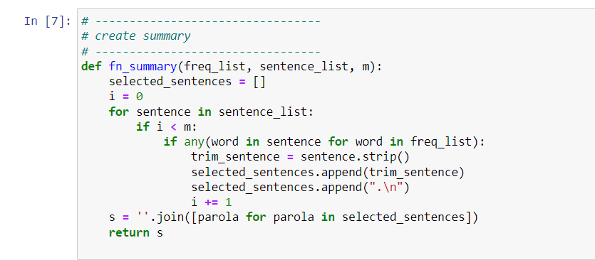
E-mail summary
Senteces selection with most frequent words – fn_summary

Slide 15
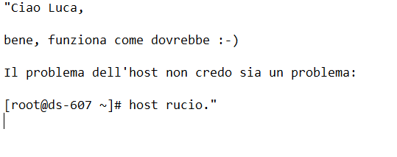
fn_summary

Slide 16
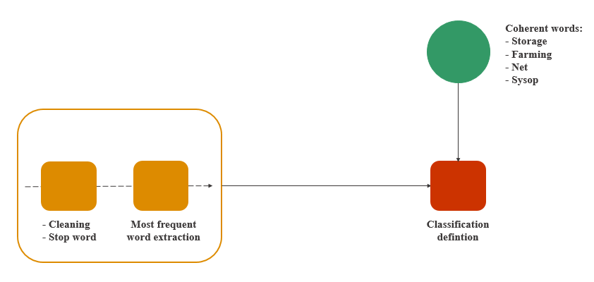
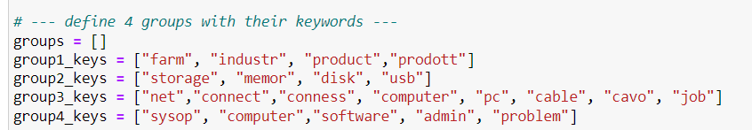
E-mail classification
Coherent words: Storage – Farming – Net - Sysop

Slide 17
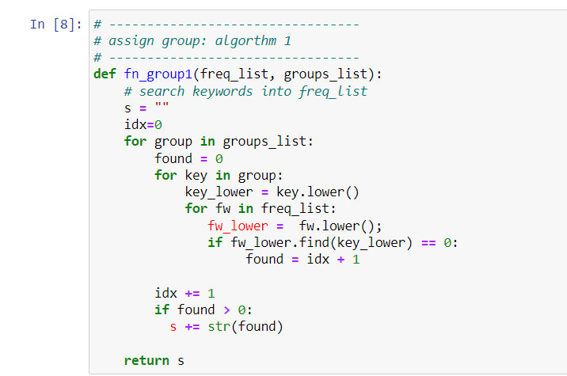
E-mail classification
Classification defintion - fn_group1

Slide 18
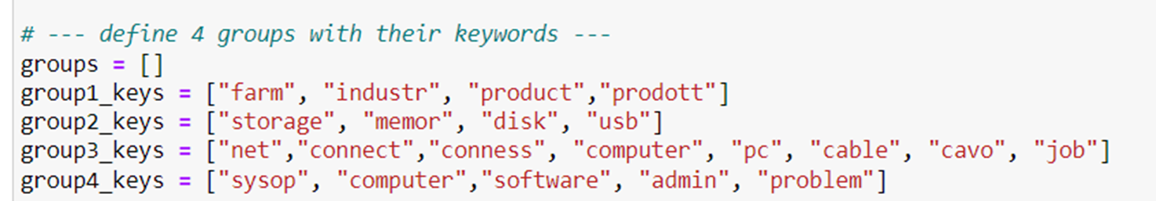
fn_group1
4

Slide 19
Classification defintion – Alternative Method
Subject and Content
Coherent words:
- Storage
- Farming
- Net
- Sysop

Slide 20
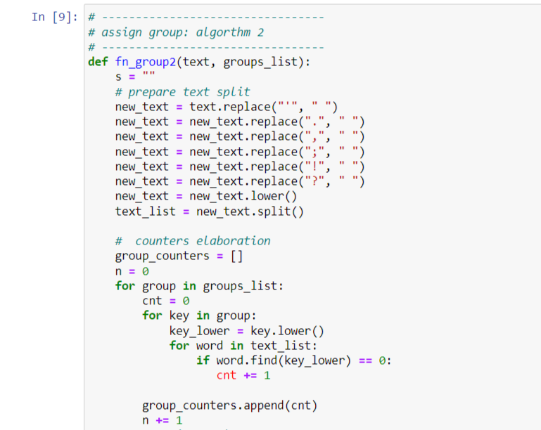
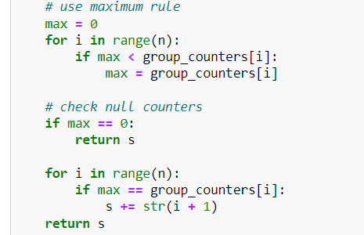
Classification defintion – Alternative Method - fn_group2

Slide 21
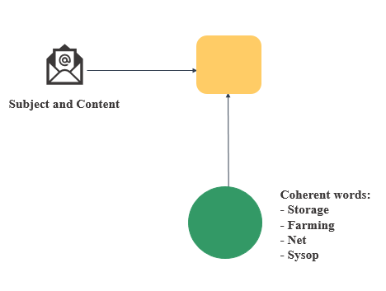
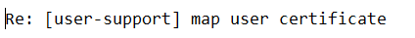
fn_group2
4

Slide 22
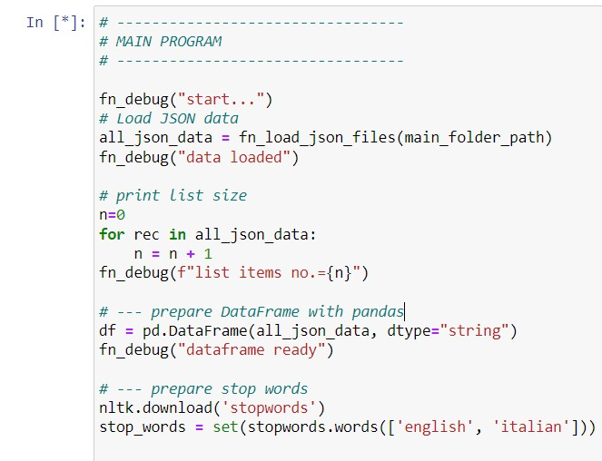
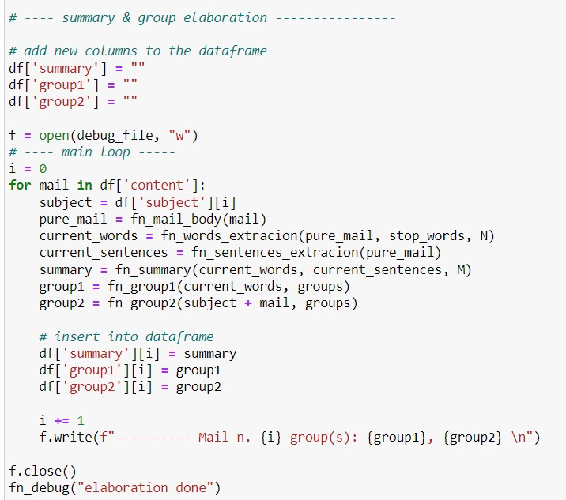
Main Program

Slide 23
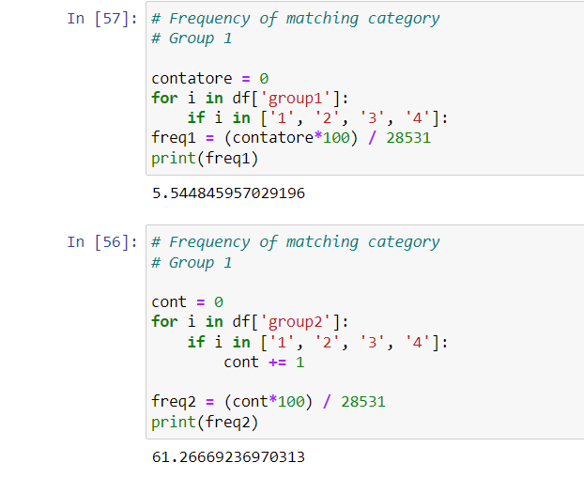
Conclusion

